Slide 1
TITTLE :
"Predicting Employee Attrition Rate using Machine Learning with Python: A Case Study on L&T Database"

Slide 2
Objective
The goal is to analyze the dataset to gain insights into the key drivers of employee attrition. This includes data preprocessing, cleaning, encoding, standardization, missing value imputation, exploratory data analysis (EDA), and building a logistic regression model to predict employee attrition.

Slide 3
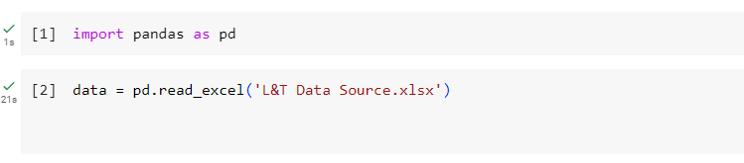
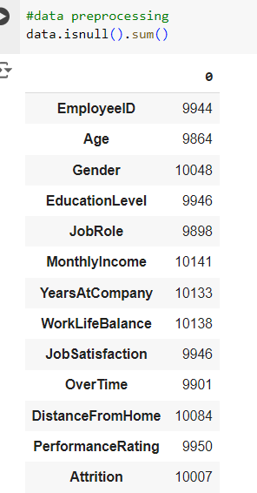
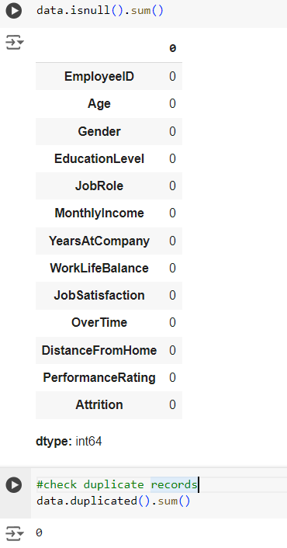
DATA PREPROCESSING
LOADING THE DATASET
2. Identify and handle missing values appropriately.

Slide 4
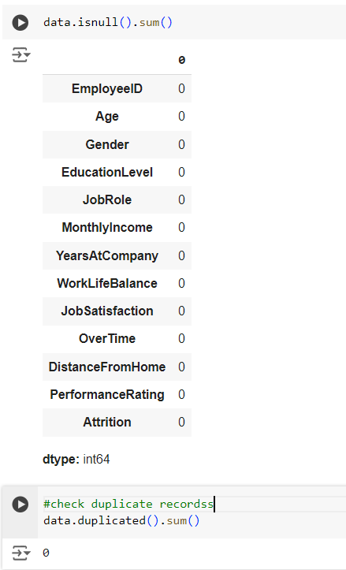
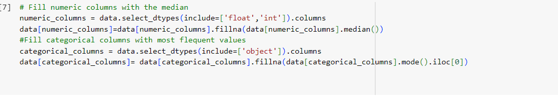
3.Encode categorical variables using suitable encoding techniques

Slide 5
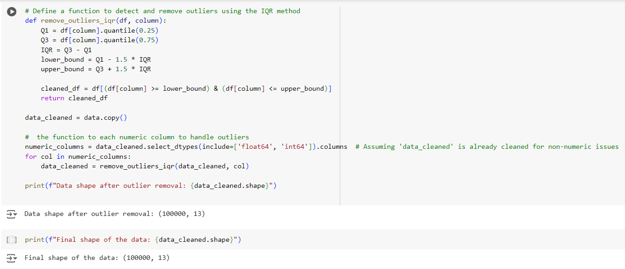
Data Cleaning
Handle any outliers in the dataset.

Slide 6
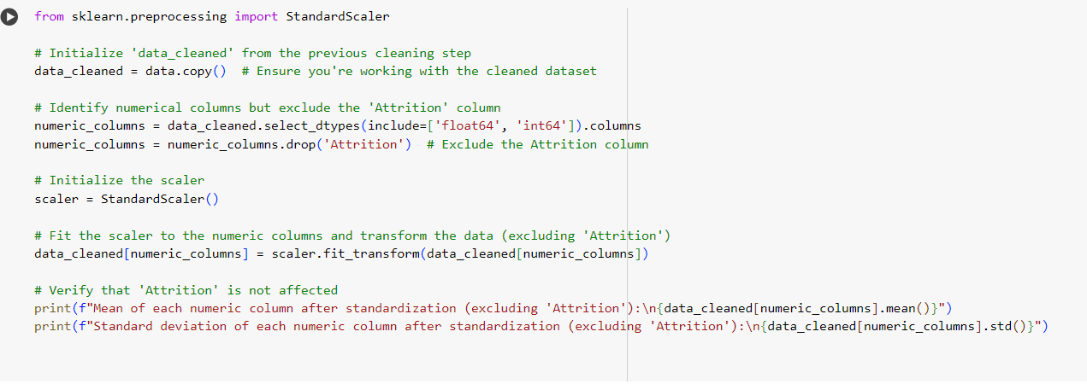
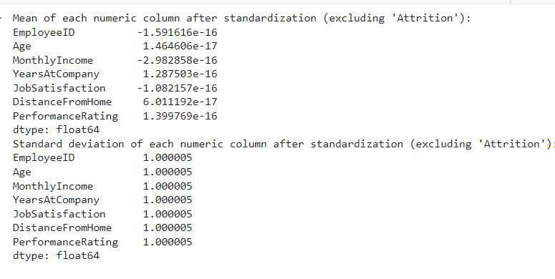
Data Standardization

Slide 7
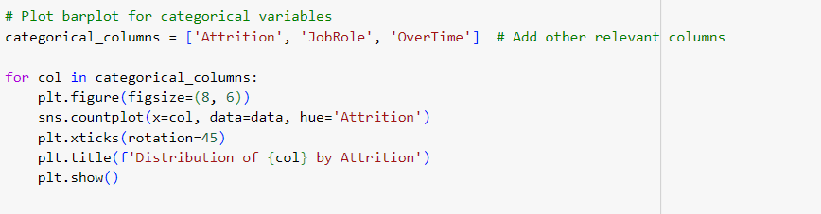
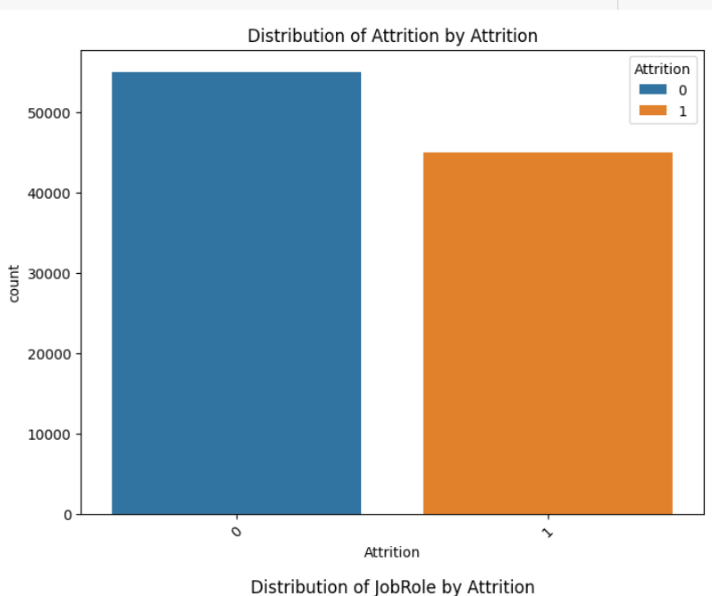
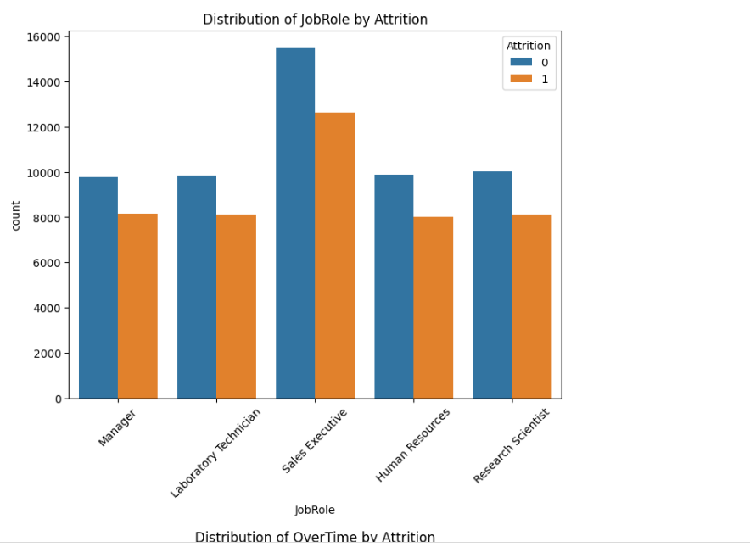
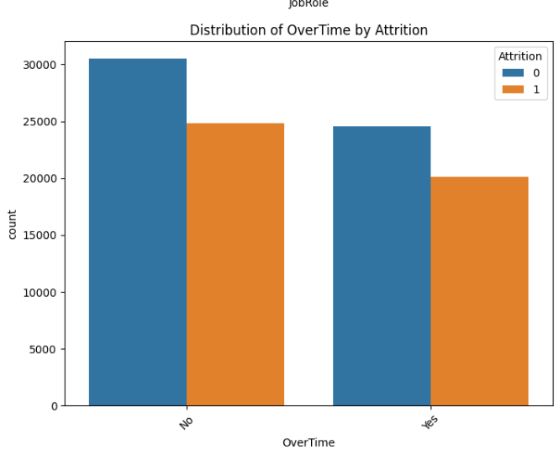
Exploratory Data Analysis
Visualize the data using plots
VISUALIZATIONS:

Slide 8
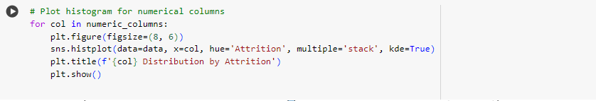
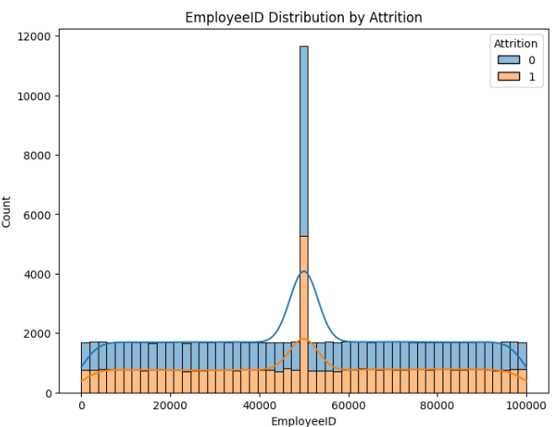
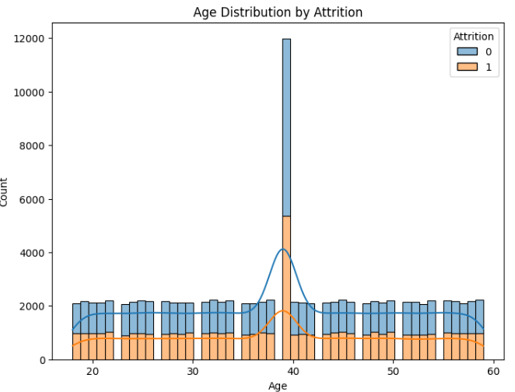
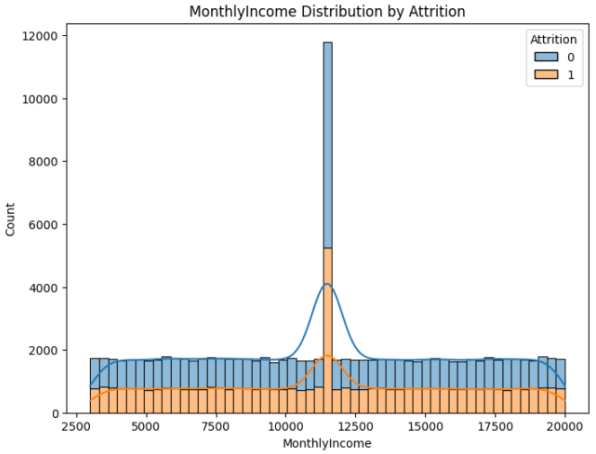
VISUALISATIONS FOR NUMERICAL COLUMNS

Slide 9
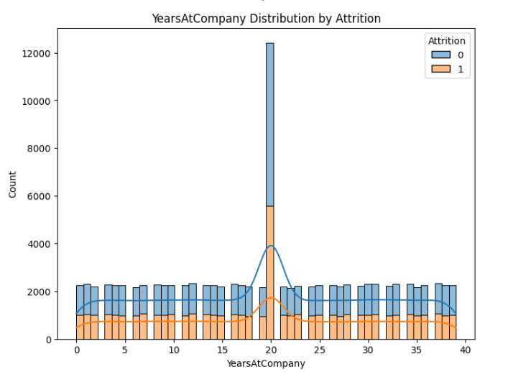
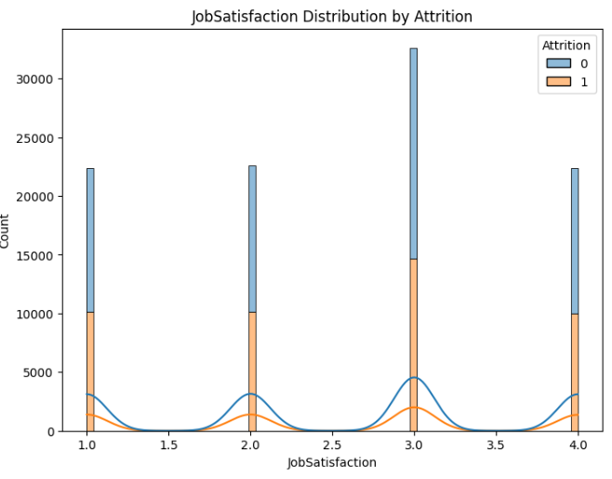
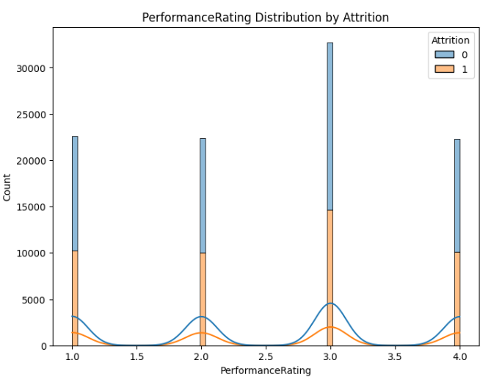

Slide 10
KEY INSIGHTS
Here are the most important insights :
Attrition is higher for employees working overtime, suggesting a potential link between overwork and turnover.
Certain job roles (e.g., Sales Executive, Research Scientist) show higher attrition, signaling the need for role-specific retention strategies.
Mid-career employees (around 40 years old) and those with 5-20 years of tenure are more likely to leave, indicating dissatisfaction or stagnation in this group.
Lower monthly income correlates with higher attrition, highlighting the importance of competitive compensation.
Job satisfaction is a strong factor—employees with lower satisfaction tend to leave more frequently.
These areas provide clear targets for improving employee retention.

Slide 11
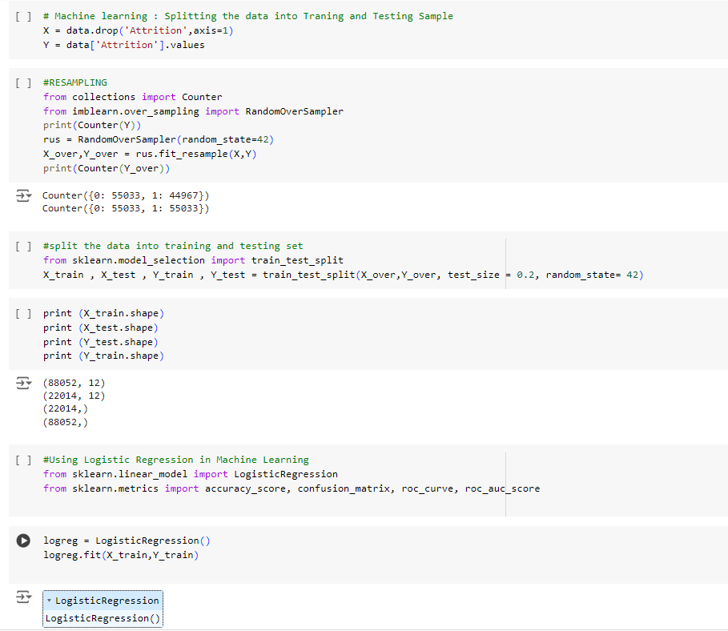
Model Building

Slide 12
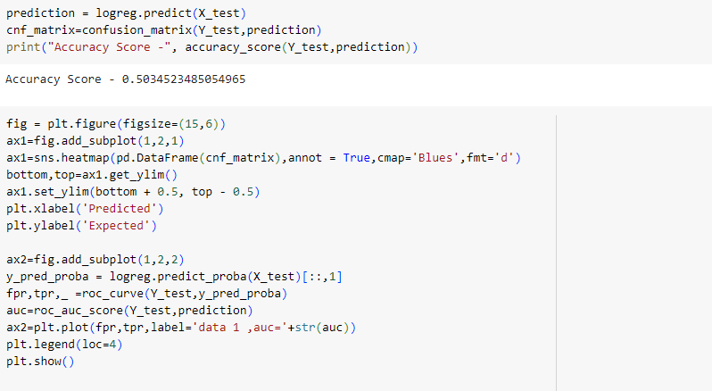
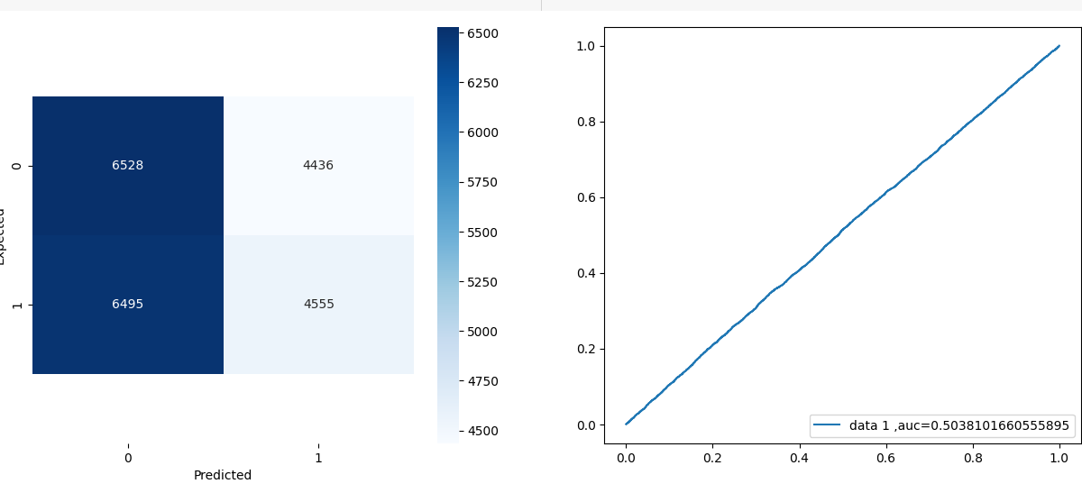
Interpretation and Reporting

Slide 13
Report: Logistic Regression Model for Employee Attrition at L&T Corp
1. Model Performance Overview
Accuracy: The logistic regression model achieved an accuracy score of 50.35%, which is only slightly better than random guessing (50%). This indicates that the model struggles to differentiate between employees who stay and those who leave.
AUC (Area Under the Curve): The AUC score is 0.5038, which also confirms the limited discriminatory ability of the model.
2. Confusion Matrix Analysis
True Positives (4,555): The model correctly identified 4,555 employees who left the company.
True Negatives (6,528): It also correctly identified 6,528 employees who stayed.
False Positives (4,436): A significant number of employees who stayed were incorrectly predicted to leave.
False Negatives (6,495): Likewise, a large portion of employees who left were incorrectly predicted to stay.
3. Key Insights
Imbalanced Classes: Despite resampling, there is still difficulty in predicting employee attrition due to the inherent complexity and variety of factors influencing it.
Overtime: From the EDA, overtime plays a major role in attrition. Employees working overtime are more likely to leave, highlighting the need for work-life balance improvements.
Salary & Job Satisfaction: Lower monthly income and lower job satisfaction are directly correlated with higher attrition, which signals the need for better compensation structures and employee engagement programs.
Mid-Career Employees: Employees around the age of 40 and with 5-20 years of tenure are at a higher risk of leaving. This suggests dissatisfaction at mid-career points.

Slide 14
Recommendations for L&T Corp
Improve Work-Life Balance: Introduce policies to reduce overtime and offer flexible working hours to combat burnout.
Enhance Compensation Packages: Consider revising salary structures, particularly for lower-paid employees, to boost retention.
Targeted Retention Programs: Implement career development programs, especially for mid-career employees who are more likely to leave due to career stagnation.
Job Satisfaction Initiatives: Conduct employee satisfaction surveys and make improvements in areas where dissatisfaction is high to decrease turnover.

